Slide 1

Insights prediction through exploratory data Analysis
Crime data analysis
Project No. : GS4
Devanshi Mathan - 221B142
Yashasvi Grover - 221B460
Lakshya Jha - 221B218
Under the guidance of Dr. Gaurav Saxena

Slide 2
Index
Introduction
Tools and Technologies
Infosys Springboard
Work-Flow
Methodology
Real-life application
References
Project No. GS4

Slide 3
Introduction
- Data Science
Data Science:
Applications:
A multidisciplinary field that combines statistical analysis, data engineering, and machine learning to extract insights from structured and unstructured data.
Focuses on solving real-world problems by transforming raw data into actionable insights.
Fraud detection
Recommendation systems
Autonomous vehicles
Predictive analytics
Healthcare diagnostics
and more.
Project No. GS4

Slide 4
Introduction
- Project
Problem to solve:
Overview:
"Where and when do crimes occur most frequently?" or "What factors correlate with high crime rates?"
This project is designed to predict crime hotspots based on location and time. By analyzing crime data, the system identifies areas that are more prone to criminal activities and determines the most dangerous time slots.
Project No. GS4

Slide 5
Tools and technologies
Python - Data cleaning, preprocessing, and visualization.
Pandas - Managing dataset.
Power BI - Data visualization and dashboard creation
Python Libraries – scipy, numpy
Jupyter Notebook - For documenting the analysis process
Infosys Springboard Courses.
Project No. GS4

Slide 6
Infosys springboard courses
Crime Data Analysis
Data Visualization using Power BI:
Learning Microsoft Power BI
Power BI for Business Professionals
Project No. GS4

Slide 7
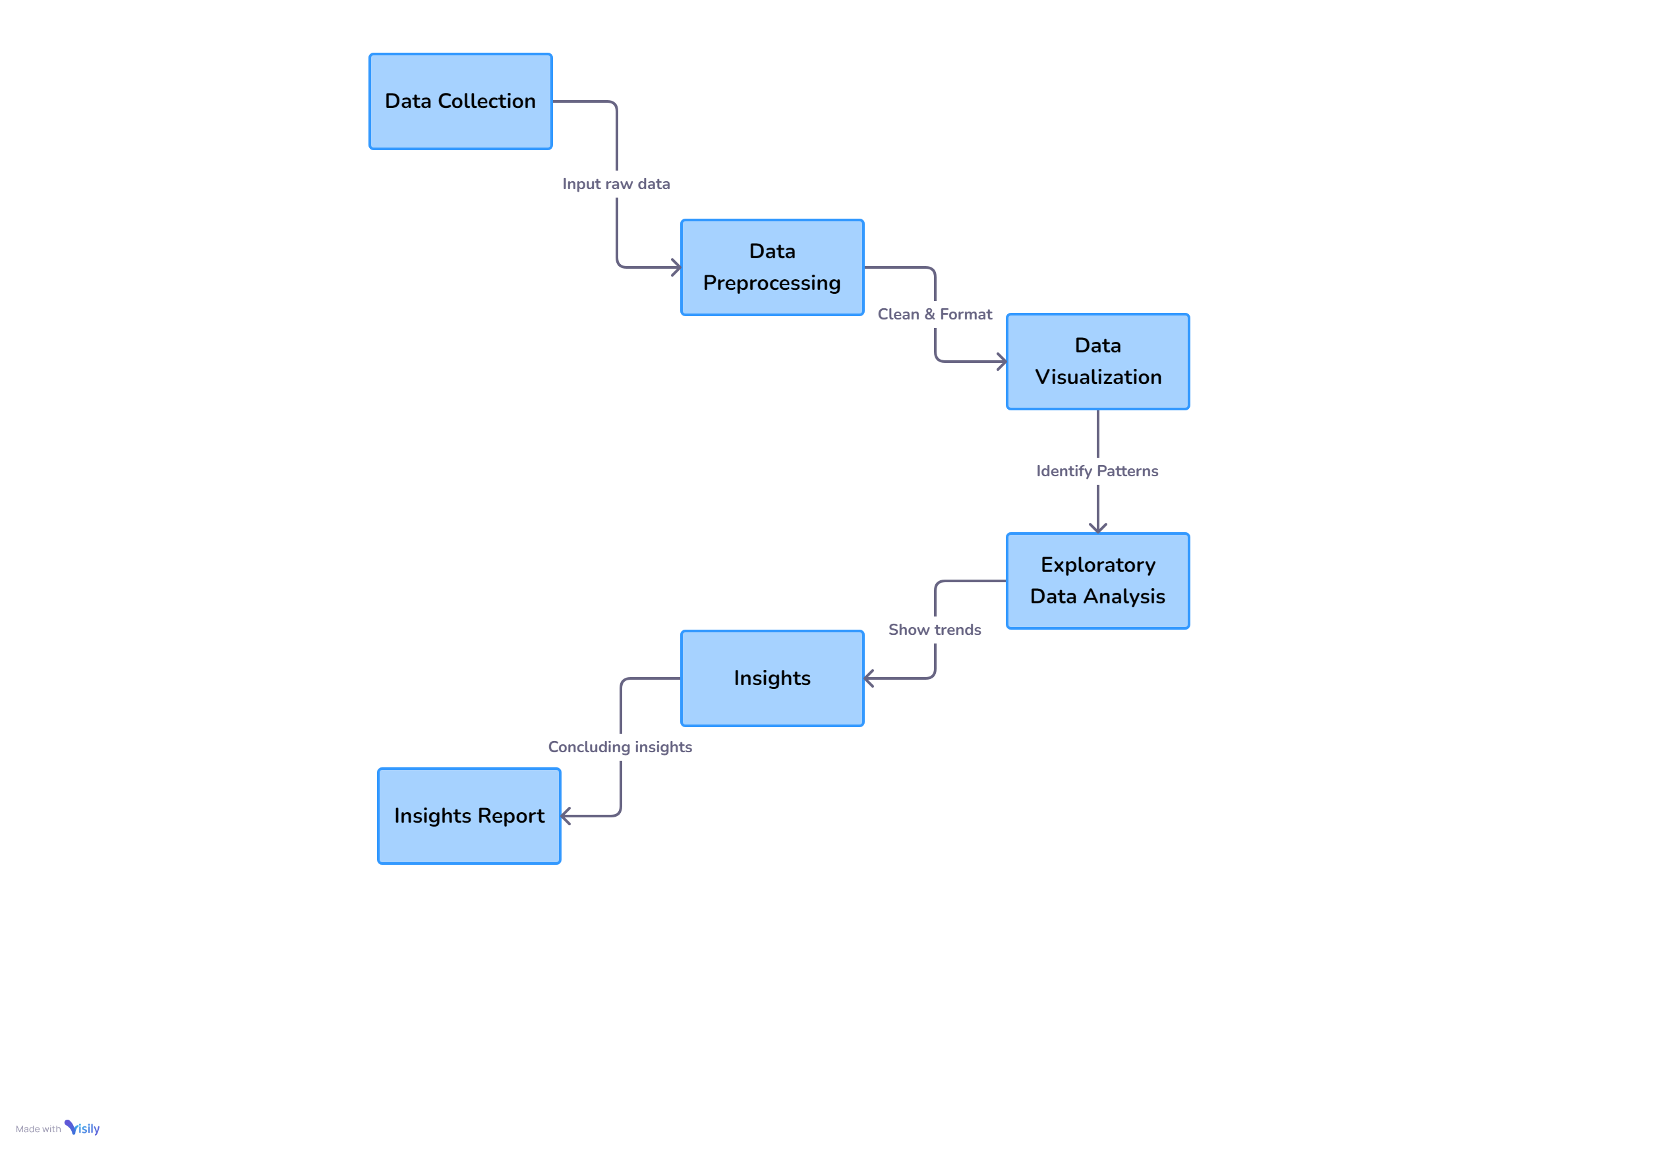
Work Flow
Project No. GS4

Slide 8
Methodology
- Data Collection
Raw data has been taken from Kaggle.
https://www.kaggle.com/ankkur13/boston-crime-data
Dataset contains INCIDENT_NUMBER, OFFENCE_CODE, OFFENSE_CODE_GROUP, OFFENCE_DESCRIPTION, DISTRICT, REPORTING_AREA, SHOOTING, OCCURRED_ON_DATE, YEAR, MONTH, UCR_PART, STREET, LAT, LONG, LOCATION.
Project No. GS4

Slide 9
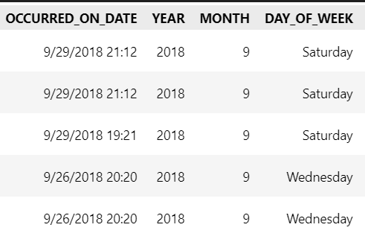
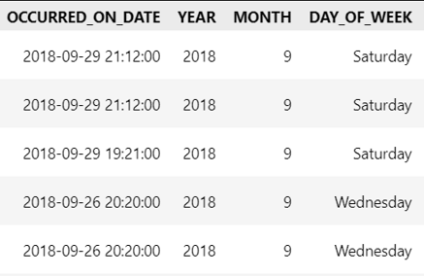
Methodology
- Data Preprocessing
Correcting data types.
Handling missing values.
Fig. 1: Before transformation
Fig. 2: After transformation
Project No. GS4

Slide 10
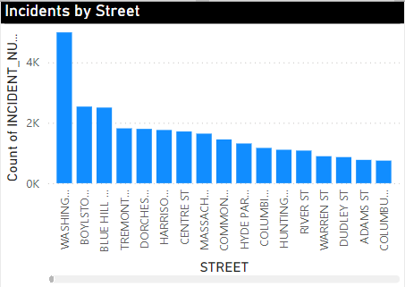
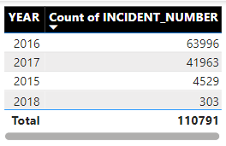
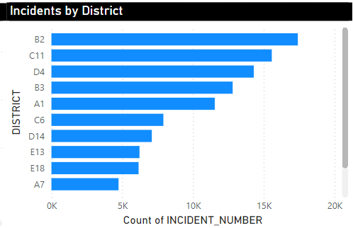
Methodology
- Data Visualization
Fig. 3: Visualization in the form of graphs.
Project No. GS4

Slide 11
Methodology
- Data Visualization
Power BI dashboard :
Incident by Street
Incident by Hour of the day.
Incident by Day of the week.
Incident by District.
Incident by UCR Part
Incident by types of crime.
Incident by years.
Incidents by Month.
Project No. GS4

Slide 12
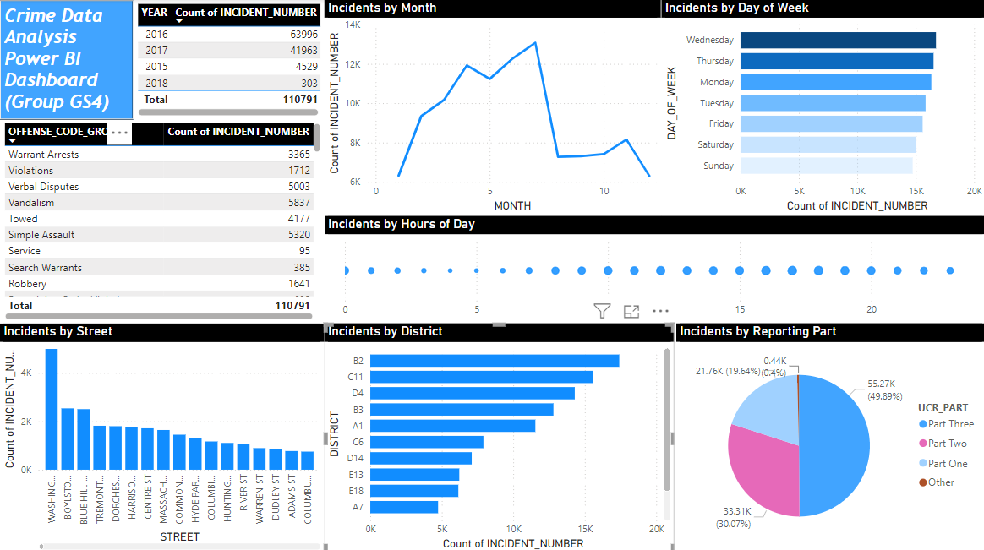
Methodology
- Data Visualization (Power BI Dashboard)
Project No. GS4

Slide 13
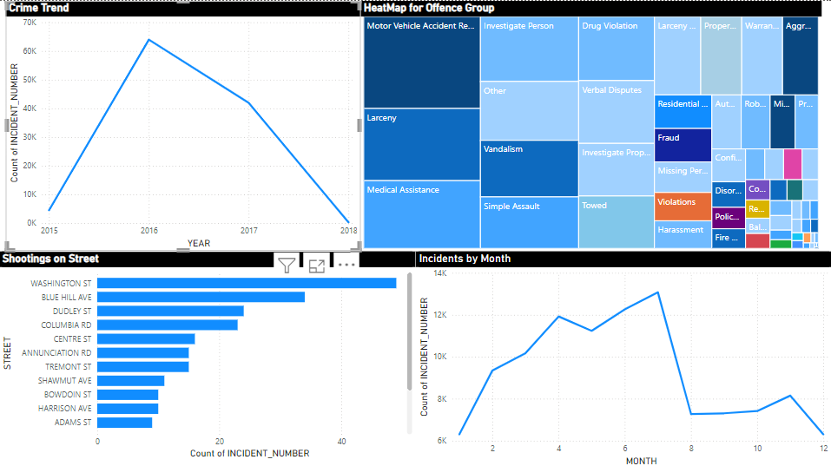
Methodology
- Data Visualization (Power BI Dashboard)
Project No. GS4

Slide 14
Methodology
- Exploratory Data Analysis
Identify patterns in the data through descriptive statistics and preliminary analysis.
Perform groupings by categories such as day of the week, district, or offense type to explore crime distributions.
Identify patterns like most common crime types, high-crime districts, and times of occurrence.
Project No. GS4

Slide 15
Methodology
- Insights
Identify correlations between variables (e.g., time of day, location, crime type)
Analyze the patterns.
These insights can be further used for modeling and predictions.
Project No. GS4

Slide 16
Methodology
- Insights Report
Summarize key insights from the analysis, such as :
dangerous areas,
peak crime hours, and
frequent crime types.
Provide actionable recommendations for law enforcement, such as:
resource optimization,
patrolling schedules, or
crime prevention strategies.
Project No. GS4

Slide 17
Real-life Application
Crime Hotspot Detection
Resource Allocation Optimization
Public Safety and Awareness Programs
Improved Response Time
Urban Planning and Policy-Making
Predictive Policing
Project No. GS4

Slide 18
Conclusion
Recognizing these patterns can help law enforcement agencies design more comprehensive and balanced crime prevention strategies, ensuring that interventions do not simply relocate criminal activities but reduce them more effectively across both place and time.
Project No. GS4

Slide 19
Conclusion
High Crime in Washington Street/B2 District: Deploy CCTV, assign foot patrols during peak hours,
and organize community events to enhance cooperation.
Seasonal Trends (Summer Spike): Increase summer patrols, run safety awareness campaigns,
and secure public events.
Midweek Peaks (Wed/Thu): Allocate more officers midweek and investigate repeat offender patterns.
Project No. GS4

Slide 20
Conclusion
Motor Vehicle Accidents & Larceny: Install traffic cameras, conduct violation checks, promote anti-theft
measures, and educate the public.
Weekend Underreporting: Improve reporting channels and shift resources to midweek.
Time-of-Day Trends: Maintain 24/7 patrols and use predictive analytics for high-risk times.
Serious Crimes: Form task forces for severe crimes and raise awareness about stricter penalties.
Project No. GS4

Slide 21
references
Ankkur13. (n.d.). Boston crime data [Data set]. Kaggle.
https://www.kaggle.com/ankkur13/boston-crime-data
Microsoft. (n.d.). Power BI documentation.
https://learn.microsoft.com/en-us/power-bi/guidance/
W3Schools. (n.d.). Data analysis fundamentals.
https://www.w3schools.com/training/aws/data-analytics-fundamentals.php
Project No. GS4

Slide 22
references
Python for Data Analysis by Alex the Analyst (Youtube)
https://www.youtube.com/playlist?list=PLUaB-1hjhk8FE_XZ87vPPSfHqb6OcM0cF
Power BI Tutorial by WsCube Tech (Youtube)
https://www.youtube.com/watch?v=bQ-HTp-tx40
Data Analytics Made Accessible By Anil Maheshwari (Book)
This book fills the need for a concise and conversational book on the hot and growing field of Data Science
Project No. GS4

Slide 23
Thank You

